Slide 1
N5 Computing Science
Database Design and Development
Notes:
Attribute: camelCase
Entity: EachWordCapitailised

Slide 2
Plan – N5 Year 1
SDD
Software Design and Development (40%)
DDD
Database Design and Development (25%)
WDD
Web Design and Development (25%)
Computer Systems (10%)
Sys
Notes:
Hide as appropriate

Slide 3
What is a database?
A database is used to store information
Able to search for information
Computerised
Notes:
Used on websites – Amazon
Used by government – HMRC, DVLA
Used by school – SEEMIS

Slide 4
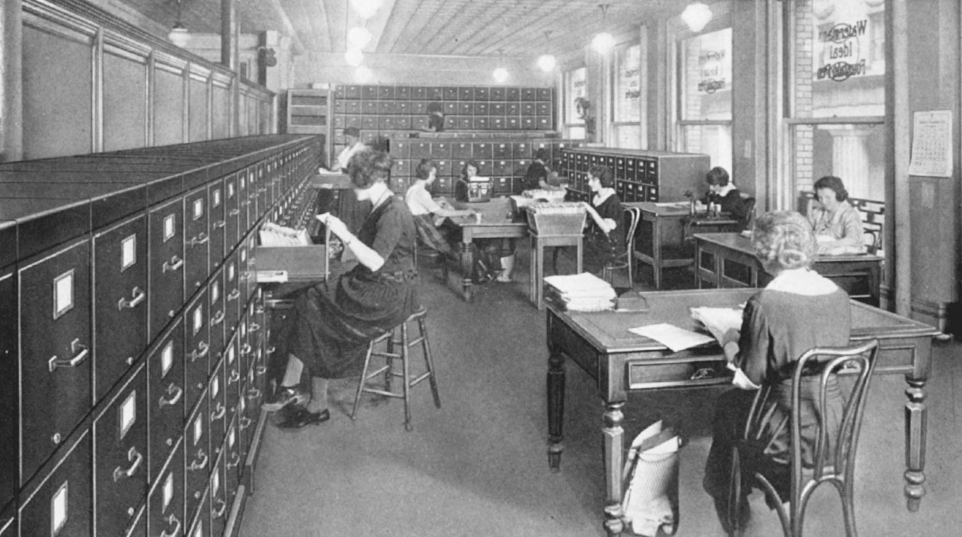
Notes:
Imagine visiting a shopping website (Amazon) and all the images, information, and prices had to be retrieved by hand!
Image: https://placesjournal.org/article/the-filing-cabinet-and-20th-century-information-infrastructure/ (School office ~1923 ☺)

Slide 5
Records – Paper based
Pupil Record
Forename: Sam
Surname: Wilson
Age: 11
Pupil Record
Forename: Kim
Surname: Young
Age: 18
Pupil Record
Forename: Peter
Surname: Jones
Age: 9
Pupil Record
Forename: Tom
Surname: Smith
Age: 6
Pupil Record
Forename: Sally
Surname: Clark
Age: 14
A record
Notes:
Olden days: filing cabinets full of records

Slide 6
Records – Paper based
Pupil Record
Forename: Sam
Surname: Wilson
Age: 11
Pupil Record
Forename: Kim
Surname: Young
Age: 18
Pupil Record
Forename: Peter
Surname: Jones
Age: 9
Pupil Record
Forename: Tom
Surname: Smith
Age: 6
Pupil Record
Forename: Sally
Surname: Clark
Age: 14
Notes:
Olden days: filing cabinets full of records

Slide 7
Records – Electronic
Data stored in table(s)
Forename | Surname | Age
Tom | Smith | 6
Peter | Jones | 9
Sally | Clark | 14
Sam | Wilson | 11
Kim | Young | 18
A field
A record
(multiple fields)

Slide 8
Records – Electronic
Forename | Surname | Age
Tom | Smith | 6
Peter | Jones | 9
Sally | Clark | 14
Sam | Wilson | 11
Kim | Young | 18

Slide 9
Relational Database
Multiple tables – each holds data on one topic
Table: Staff
Table: Department
ID | Forename | Surname | Dept ID
1 | Colin | Arthur | 001
2 | Laura | Brown | 001
3 | Stephen | MacLeod | 001
4 | Scott | Sinclair | 002
5 | Michelle | Wie | 002
ID | Dept | Phone
001 | ICT | 300
002 | English | 301
Data links tables
Notes:
Data from BBC Bitesize: https://www.bbc.co.uk/bitesize/guides/zc93tv4/revision/1

Slide 10
Relational Database
Table: Staff
Table: Department
ID | Forename | Surname | Dept ID
1 | Colin | Arthur | 001
2 | Laura | Brown | 001
3 | Stephen | MacLeod | 001
4 | Scott | Sinclair | 002
5 | Michelle | Wie | 002
ID | Dept | Phone
001 | Maths | 300
002 | English | 301

Slide 11
SQL
Structured
Query
Language
The language of databases
"SEQUEL"
Notes:
SEQUEL: Structured English QUEry Language

Slide 12
SQL
S
Q
L
The language of databases
Notes:
SEQUEL: Structured English QUEry Language

Slide 13
DB Browser for SQLite
Setup

Slide 14
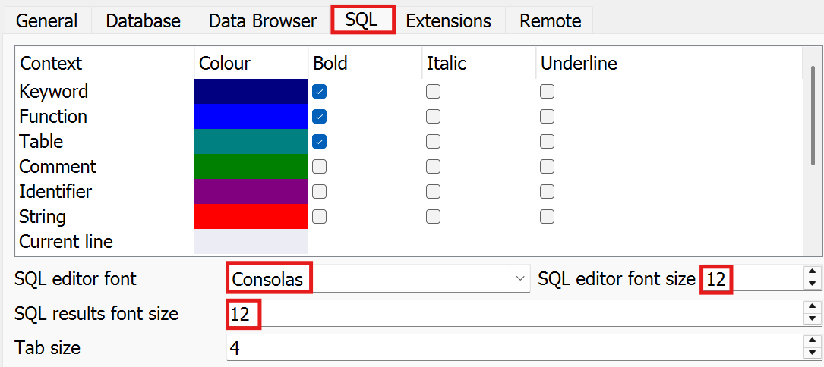
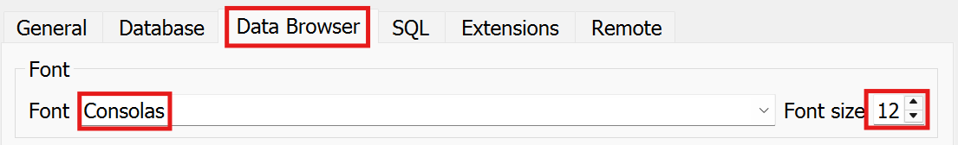
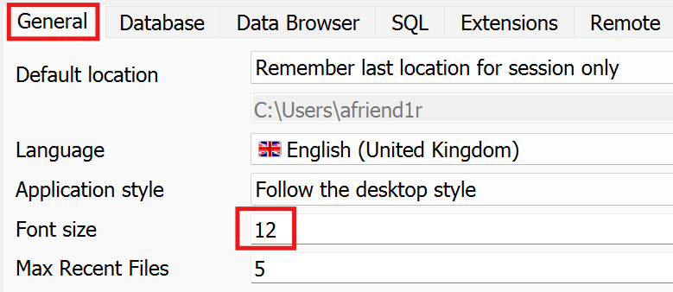
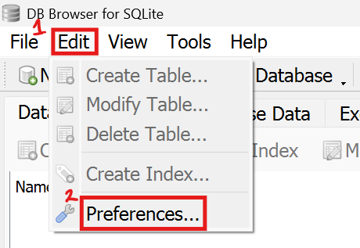

Edit – Preferences

Slide 15
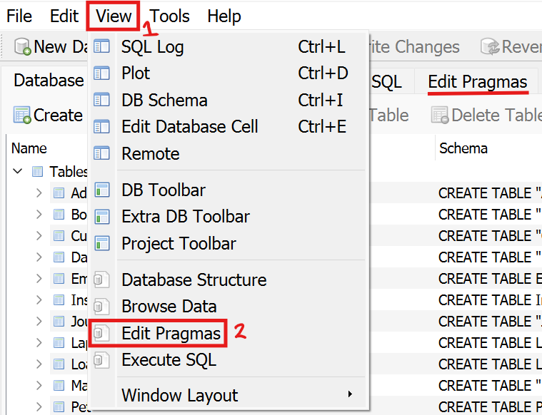
View – Edit Pragmas
Removes
Edit Pragmas
tab

Slide 16
Learning Intentions
Describe and use internal commentary

Slide 17
Internal Commentary - Single Line
Use internal commentary to help your future self
1 -- This is a comment
2 -- Another comment
Ignored by computer
Double dash (comment)
Line numbers
Notes:
Helps to tell the 'story' of what the program does

Slide 18
Internal Commentary – Single Line
Use internal commentary to help your future self
1 -- This is a comment
2 -- Another comment

Slide 19
Internal Commentary – Multiple Lines
Use internal commentary to help your future self
1 /*
2 A comment
3 Another comment
4 */
Start
Ignored by computer
End
Notes:
Helps to tell the 'story' of what the program does

Slide 20
Internal Commentary – Multiple Lines
Use internal commentary to help your future self
1 /*
2 A comment
3 Another comment
4 */
Notes:
Helps to tell the 'story' of what the program does

Slide 21
Learning Intentions
Describe and use output to screen

Slide 22
Display information
Blank line
1 .print
2 .print "Hello world"
Displayed in console
Notes:
Works in Replit but not DB Browser for SQLite

Slide 23
Display information
1 .print
2 .print "Hello world"

Slide 24
Learning Intentions
Describe and use SQL select operations

Slide 25
Table: pupil
Attribute | Key | Type | Size | Req'd | Validation
pupilID | PK | number |  | Y
firstName |  | text | 20 | Y
lastName |  | text | 20 | Y
age |  | number |  | Y | Range: >=0

Slide 26
Display Data – Everything
All fields
1 SELECT *
2 FROM Datatypes;
Table name
End of statement
SQL statements can be on a single line:
SELECT * FROM Datatypes;

Slide 27
Display Data – Everything
1 SELECT * 2 FROM Datatypes;
SQL statements can be on a single line:

Slide 28
Display Data – Something
1 SELECT colour, score, height
2 FROM Datatypes;
Field names
Separated by commas

Slide 29
Display Data – Something
1 SELECT colour, score, height
2 FROM Datatypes;

Slide 30
Order of Operations (1)
Order:
1. FROM
2. SELECT
1 SELECT name, type
2 FROM Pet;
SELECT
FROM
Output
Table: Pet
name | type | age
Pepper | Cat | 16
Cindy | Dog | 4
Snowy | Cat | 7
Micky | Mouse | 1
Minnie | Mouse | 1
Kitty | Cat | 9
Bonzo | Dog | 6
Roger | Rabbit | 3
name | type | age
Pepper | Cat | 16
Cindy | Dog | 4
Snowy | Cat | 7
Micky | Mouse | 1
Minnie | Mouse | 1
Kitty | Cat | 9
Bonzo | Dog | 6
Roger | Rabbit | 3
name | type
Pepper | Cat
Cindy | Dog
Snowy | Cat
Micky | Mouse
Minnie | Mouse
Kitty | Cat
Bonzo | Dog
Roger | Rabbit
Notes:
This happens in the computer's memory, only the output is displayed.

Slide 31
Order of Operations (1)
Order:
1.
2.
1 SELECT name, type
2 FROM Pet;
Table: Pet
name | type | age
Pepper | Cat | 16
Cindy | Dog | 4
Snowy | Cat | 7
Micky | Mouse | 1
Minnie | Mouse | 1
Kitty | Cat | 9
Bonzo | Dog | 6
Roger | Rabbit | 3
name | type | age
Pepper | Cat | 16
Cindy | Dog | 4
Snowy | Cat | 7
Micky | Mouse | 1
Minnie | Mouse | 1
Kitty | Cat | 9
Bonzo | Dog | 6
Roger | Rabbit | 3
name | type
Pepper | Cat
Cindy | Dog
Snowy | Cat
Micky | Mouse
Minnie | Mouse
Kitty | Cat
Bonzo | Dog
Roger | Rabbit

Slide 32
Learning Intentions
Describe and use <, >, = in SQL operations

Slide 33
Comparison Operators
= Equal to (same as)
> Greater than
>= Greater than or equal to
<= Less than or equal to
< Less than
<> Not equal to (not the same as)

Slide 34
Comparison Operators
Equal to (same as)
Greater than
Greater than or equal to
Less than or equal to
Less than
Not equal to (not the same as)

Slide 35
Attributes Types
Type | Description | Examples
text | One or more characters | "Hello", "01871"
number | Integer or real | 0, 0.0, 87, - 3.14
date | Year, Month, Day | "2023-11-21"
time | Hours, Minutes, Seconds | "14:00:00"
Boolean | Binary – two states | TRUE / FALSE

Slide 36
Attributes Types
Type | Description | Examples
 | One or more characters | "Hello", "01871"
 | Integer or real | 0, 0.0, 87, - 3.14
 | Year, Month, Day | "2023-11-21"
 | Hours, Minutes, Seconds | "14:00:00"
 | Binary – two states | TRUE / FALSE

Slide 37
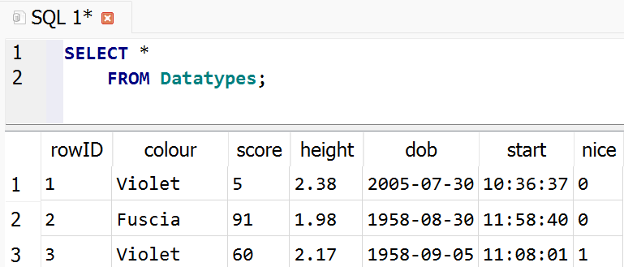
Attributes Example
1 SELECT *
2 FROM Datatypes;
Text
Number
Date
Time
Boolean

Slide 38
Attributes Example

Slide 39
Filter Results: Text
NB: Values are case sensitive!
Comparison
1 SELECT *
2 FROM Datatypes
3 WHERE colour = "Red";
Value
Field
Condition
If the condition is True the record is displayed
Notes:
SQL 'WHERE' is like Python 'if'

Slide 40
Filter Results: Text
1 SELECT *
2 FROM Datatypes
3 WHERE colour = "Red";
If the is the record is displayed

Slide 41
Order of Operations (2)
Order:
1. FROM
2. WHERE
3. SELECT
1 SELECT name, age
2 FROM Pet
3 WHERE type = "Cat";
SELECT
WHERE
FROM
Output
Table: Pet
name | type | age
Pepper | Cat | 16
Cindy | Dog | 4
Snowy | Cat | 7
Micky | Mouse | 1
Minnie | Mouse | 1
Kitty | Cat | 9
Bonzo | Dog | 6
Roger | Rabbit | 3
name | type | age
Pepper | Cat | 16
Cindy | Dog | 4
Snowy | Cat | 7
Micky | Mouse | 1
Minnie | Mouse | 1
Kitty | Cat | 9
Bonzo | Dog | 6
Roger | Rabbit | 3
name | age
Pepper | 16
Snowy | 7
Kitty | 9
Notes:
This happens in the computer's memory, only the output is displayed.

Slide 42
Order of Operations (2)
Order:
1.
2.
3.
1 SELECT name, age
2 FROM Pet
3 WHERE type = "Cat";
Table: Pet
name | type | age
Pepper | Cat | 16
Cindy | Dog | 4
Snowy | Cat | 7
Micky | Mouse | 1
Minnie | Mouse | 1
Kitty | Cat | 9
Bonzo | Dog | 6
Roger | Rabbit | 3
name | type | age
Pepper | Cat | 16
Cindy | Dog | 4
Snowy | Cat | 7
Micky | Mouse | 1
Minnie | Mouse | 1
Kitty | Cat | 9
Bonzo | Dog | 6
Roger | Rabbit | 3
name | age
Pepper | 16
Snowy | 7
Kitty | 9

Slide 43
Filter Results: Number
1 SELECT colour, score, height
2 FROM Datatypes
3 WHERE height < 1.1;
Integer or Real
If the condition is TRUE the fields are displayed

Slide 44
Filter Results: Number
1 SELECT colour, score, height
2 FROM Datatypes
3 WHERE height < 1.1;
If the condition is the fields are displayed

Slide 45
Filter Results: Date
1 SELECT dob, start, nice
2 FROM Datatypes
3 WHERE dob > "1999-12-31";
YYYY-MM-DD
If the condition is TRUE the fields are displayed
Notes:
YYYY-MM-DD

Slide 46
Filter Results: Date
1 SELECT dob, start, nice
2 FROM Datatypes
3 WHERE dob > "1999-12-31";
If the condition is the fields are displayed

Slide 47
Filter Results: Time
1 SELECT dob, start, nice
2 FROM Datatypes
3 WHERE start >= "13:10:00";
HH:MM:SS
If the condition is TRUE the fields are displayed
Notes:
HH:MM:SS

Slide 48
Filter Results: Time
1 SELECT made, start, nice
2 FROM Datatypes
3 WHERE start >= "13:10:00";
If the condition is the fields are displayed

Slide 49
Filter Results: Boolean
1 SELECT *
2 FROM Datatypes
3 WHERE nice = TRUE;
TRUE / FALSE
If the condition is TRUE the row is displayed

Slide 50
Filter Results: Boolean
1 SELECT *
2 FROM Datatypes
3 WHERE nice = TRUE;
If the condition is the fields are displayed

Slide 51
Learning Intentions
Describe and use SQL order by operations

Slide 52
Sort Results – Small to Big
1 SELECT firstName, lastName, age
2 FROM Pupil
3 WHERE lastName = "MacNeil"
4 ORDER BY age ASC;
Field
Order
ASC = ascending
(a,b,c, … 0,1,2, …)
Notes:
Can order by fields that aren't displayed.

Slide 53
Sort Results – Small to Big
1 SELECT firstName, lastName, age
2 FROM Pupil
3 WHERE lastName = "MacNeil"
4 ORDER BY age ASC;
ASC =

Slide 54
Sort Results – Big to Small
1 SELECT firstName, lastName, age
2 FROM Pupil
3 WHERE age = 12
4 ORDER BY firstName DESC;
DESC = descending
(z,y,x, … 9,8,7, …)

Slide 55
Sort Results – Big to Small
1 SELECT firstName, lastName, age
2 FROM Pupil
3 WHERE age = 12
4 ORDER BY firstName DESC;
DESC =

Slide 56
Order of Operations (3)
Order:
1. FROM
2. WHERE
3. SELECT
4. ORDER BY
1 SELECT name, age
2 FROM Pet
3 WHERE age < 5
4 ORDER BY type DESC;
SELECT
WHERE
ORDER BY
FROM
Output
Table: Pet
name | type | age
Pepper | Cat | 16
Cindy | Dog | 4
Snowy | Cat | 7
Mickey | Mouse | 1
Minnie | Mouse | 1
Kitty | Cat | 9
Bonzo | Dog | 6
Roger | Rabbit | 3
name | type | age
Pepper | Cat | 16
Cindy | Dog | 4
Snowy | Cat | 7
Mickey | Mouse | 1
Minnie | Mouse | 1
Kitty | Cat | 9
Bonzo | Dog | 6
Roger | Rabbit | 3
name | type | age
Roger | Rabbit | 3
Mickey | Mouse | 1
Minnie | Mouse | 1
Cindy | Dog | 4
Bonzo | Dog | 6
Pepper | Cat | 16
Snowy | Cat | 7
Kitty | Cat | 9
name | age
Roger | 3
Mickey | 1
Minnie | 1
Cindy | 4
Notes:
Highlighting field not selected but can still be used for ordering (H CS: think aliases)

Slide 57
Order of Operations (3)
Order:
1.
2.
3.
4.
1 SELECT name, age
2 FROM Pet
3 WHERE age < 5
4 ORDER BY type DESC;
Table: Pet
name | type | age
Pepper | Cat | 16
Cindy | Dog | 4
Snowy | Cat | 7
Mickey | Mouse | 1
Minnie | Mouse | 1
Kitty | Cat | 9
Bonzo | Dog | 6
Roger | Rabbit | 3
name | type | age
Pepper | Cat | 16
Cindy | Dog | 4
Snowy | Cat | 7
Mickey | Mouse | 1
Minnie | Mouse | 1
Kitty | Cat | 9
Bonzo | Dog | 6
Roger | Rabbit | 3
name | type | age
Roger | Rabbit | 3
Mickey | Mouse | 1
Minnie | Mouse | 1
Cindy | Dog | 4
Bonzo | Dog | 6
Pepper | Cat | 16
Snowy | Cat | 7
Kitty | Cat | 9
name | age
Roger | 3
Mickey | 1
Minnie | 1
Cindy | 4

Slide 58
Order of Operations (3)
Order:
1. FROM
2. WHERE
3. SELECT
4. ORDER BY
1 SELECT name, age
2 FROM Pet
3 WHERE age < 5
4 ORDER BY type DESC;
WHERE
SELECT
ORDER BY
FROM
Output
Table: Pet
name | type | age
Pepper | Cat | 16
Cindy | Dog | 4
Snowy | Cat | 7
Mickey | Mouse | 1
Minnie | Mouse | 1
Kitty | Cat | 9
Bonzo | Dog | 6
Roger | Rabbit | 3
name | type | age
Pepper | Cat | 16
Cindy | Dog | 4
Snowy | Cat | 7
Mickey | Mouse | 1
Minnie | Mouse | 1
Kitty | Cat | 9
Bonzo | Dog | 6
Roger | Rabbit | 3
name | type | age
Cindy | Dog | 4
Mickey | Mouse | 1
Minnie | Mouse | 1
Roger | Rabbit | 3
name | type | age
Roger | Rabbit | 3
Mickey | Mouse | 1
Minnie | Mouse | 1
Cindy | Dog | 4
name | age
Roger | 3
Mickey | 1
Minnie | 1
Cindy | 4
Notes:
Highlighting field not selected but can still be used for ordering (H CS: think aliases)

Slide 59
Order of Operations (3)
Order:
1.
2.
3.
4.
1 SELECT name, age
2 FROM Pet
3 WHERE age < 5
4 ORDER BY type DESC;
Table: Pet
name | type | age
Pepper | Cat | 16
Cindy | Dog | 4
Snowy | Cat | 7
Mickey | Mouse | 1
Minnie | Mouse | 1
Kitty | Cat | 9
Bonzo | Dog | 6
Roger | Rabbit | 3
name | type | age
Pepper | Cat | 16
Cindy | Dog | 4
Snowy | Cat | 7
Mickey | Mouse | 1
Minnie | Mouse | 1
Kitty | Cat | 9
Bonzo | Dog | 6
Roger | Rabbit | 3
name | type | age
Cindy | Dog | 4
Mickey | Mouse | 1
Minnie | Mouse | 1
Roger | Rabbit | 3
name | type | age
Roger | Rabbit | 3
Mickey | Mouse | 1
Minnie | Mouse | 1
Cindy | Dog | 4
name | age
Roger | 3
Mickey | 1
Minnie | 1
Cindy | 4

Slide 60
Sort Results – Multiple fields
1 SELECT firstName, lastName, age
2 FROM Pupil
3 WHERE age >= 11
4 ORDER BY age DESC,
5 lastName ASC;
Comma
1st sort
2nd sort
When age is the same, sorts by lastName

Slide 61
Sort Results – Multiple fields
1 SELECT firstName, lastName, age
2 FROM Pupil
3 WHERE age >= 11
4 ORDER BY age DESC,
5 lastName ASC;

Slide 62
Learning Intentions
Describe and use AND / OR in SQL operations
Notes:
NOT isn't in the spec.
WHERE NOT age = 11 (WHERE age <> 11) - Everyone but the 11 year olds

Slide 63
Filter Results: Complex - AND
1 SELECT *
2 FROM Datatypes
3 WHERE colour = "Green"
4 AND nice = FALSE;
If the overall condition is TRUE the row is displayed

Slide 64
Filter Results: Complex - AND
1 SELECT *
2 FROM Datatypes
3 WHERE colour = "Green"
4 AND nice = FALSE;
If the condition is the row is displayed

Slide 65
Filter Results: Complex - OR
1 SELECT *
2 FROM Datatypes
3 WHERE colour = "Green"
4 OR nice = FALSE;
If the overall condition is TRUE the row is displayed

Slide 66
Filter Results: Complex - OR
1 SELECT *
2 FROM Datatypes
3 WHERE colour = "Green"
4 OR nice = FALSE;
If the condition is the row is displayed

Slide 67
Filter Results: Complex!
1 SELECT *
2 FROM Datatypes
3 WHERE (colour = "Green"
4 OR colour = "Violet")
5 AND nice = FALSE;
Use brackets for clarity
If the overall condition is TRUE the row is displayed

Slide 68
Filter Results: Complex!
1 SELECT *
2 FROM Datatypes
3 WHERE (colour = "Green"
4 OR colour = "Violet")
5 AND nice = FALSE;
If the condition is the row is displayed

Slide 69
Order of Operations (4)
Order:
1. FROM
2. WHERE
3. SELECT
4. ORDER BY
1 SELECT name, age
2 FROM Pet
3 WHERE type = "Cat"
4 AND age < 10
5 ORDER BY name ASC;
WHERE
SELECT
FROM
Output
Table: Pet
name | type | age
Pepper | Cat | 16
Cindy | Dog | 4
Snowy | Cat | 7
Mickey | Mouse | 1
Minnie | Mouse | 1
Kitty | Cat | 9
Bonzo | Dog | 6
Roger | Rabbit | 3
name | type | age
Pepper | Cat | 16
Cindy | Dog | 4
Snowy | Cat | 7
Mickey | Mouse | 1
Minnie | Mouse | 1
Kitty | Cat | 9
Bonzo | Dog | 6
Roger | Rabbit | 3
name | type | age
Snowy | Cat | 7
Kitty | Cat | 9
name | type | age
Kitty | Cat | 9
Snowy | Cat | 7
name | age
Kitty | 9
Snowy | 7
ORDER BY
Notes:
Ordering: think aliases (H CS)

Slide 70
Order of Operations (4)
Order:
1.
2.
3.
4.
1 SELECT name, age
2 FROM Pet
3 WHERE type = "Cat"
4 AND age < 10
5 ORDER BY name ASC;
Table: Pet
name | type | age
Pepper | Cat | 16
Cindy | Dog | 4
Snowy | Cat | 7
Mickey | Mouse | 1
Minnie | Mouse | 1
Kitty | Cat | 9
Bonzo | Dog | 6
Roger | Rabbit | 3
name | type | age
Pepper | Cat | 16
Cindy | Dog | 4
Snowy | Cat | 7
Mickey | Mouse | 1
Minnie | Mouse | 1
Kitty | Cat | 9
Bonzo | Dog | 6
Roger | Rabbit | 3
name | type | age
Snowy | Cat | 7
Kitty | Cat | 9
name | type | age
Kitty | Cat | 9
Snowy | Cat | 7
name | age
Kitty | 9
Snowy | 7

Slide 71
Prison Task
Complete the Prison tasks

Slide 72
Doing It All!
1 SELECT firstName, lastName, age
2 FROM pupil
3 WHERE lastName = "Smith"
4 AND age >= 12
5 ORDER BY firstName ASC,
6 age DESC;

Slide 73
Doing It All!
1 SELECT firstName, lastName, age
2 FROM pupil
3 WHERE lastName = "Smith"
4 AND age >= 12
5 ORDER BY firstName ASC, 6 age DESC;

Slide 74
Santa's List
Write a SQL statement to help Santa
with delivering presents.
He wants to know the forename,
surname, and gift ID for everyone
who has been nice this year.
He wants to deliver the presents in
reverse order for surnames but alphabetical for forenames.
gift
giftID
first
last
nice
number
text
text
boolean

Slide 75
Santa's List - SQL
1 SELECT first, last, giftID
2 FROM gift
3 WHERE nice = TRUE
4 ORDER BY last DESC,
5 first ASC;
gift
giftID
first
last
nice
number
text
text
boolean

Slide 76
Video Games Task
Complete the Video Games tasks

Slide 77
Learning Intentions
Describe and use SQL equi-joins between tables

Slide 78
Primary Key (PK)
Entity
Table
taxiID
make
colour
Taxi
taxiID | make | colour
5 | Ford | Teal
12 | Buick | Crimson
13 | Buick | Teal
17 | Ford | Mauve
Primary Key: underlined
Primary Key: unique value
Every table has a PK – used to identify records and link tables
Notes:
Design: Entity
Implementation: Table

Slide 79
Primary Key (PK)
taxiID
make
colour
Taxi
taxiID | make | colour
5 | Ford | Teal
12 | Buick | Crimson
13 | Buick | Teal
17 | Ford | Mauve

Slide 80
Foreign Key (FK)
Table: Taxi
Table: Trip
taxiID | make | colour
5 | Ford | Teal
12 | Buick | Crimson
13 | Buick | Teal
17 | Ford | Mauve
tripID | taxiID | cost
1 | 17 | 7.75
2 | 5 | 21.80
3 | 12 | 5.20
4 | 17 | 11.00
5 | 13 | 9.25
Primary Key
Primary Key
Foreign Key: Primary Key of another table
Notes:
Design: Entity
Implementation: Table

Slide 81
Foreign Key (FK)
taxiID | make | colour
5 | Ford | Teal
12 | Buick | Crimson
13 | Buick | Teal
17 | Ford | Mauve
tripID | taxiID | cost
1 | 17 | 7.75
2 | 5 | 21.80
3 | 12 | 5.20
4 | 17 | 11.00
5 | 13 | 9.25

Slide 82
Relationship – Two Entities
makes
taxiID
taxiReg
make
model
colour
Taxi
Journey
journey
journeyID
taxiID*
pickUpDate
pickUpTime
pax
pickUp
dropOff
A taxi can make
many journeys
Primary Key: underlined
Foreign Key: suffixed with *
Notes:
Design: Entity
Implementation: Table

Slide 83
Relationship – Two Entities
taxiID
taxiReg
make
model
colour
Taxi
Journey
journey
journeyID
taxiID*
pickUpDate
pickUpTime
pax
pickUp
dropOff

Slide 84
Entity: Address
Attribute | Key | Size | Type | Req'd | Validation
addressID | PK |  | number | Y
pupilID | FK |  | number | Y | Exists in pupil table
firstLine |  | 20 | text | Y
town |  | 15 | text | Y
postcode |  | 8 | text | Y
phone |  | 15 | text
Notes:
Need a second table

Slide 85
Relationship – Two Entities
Pupil
pupilID
firstName
lastName
age
Address
addressID
pupilID*
firstLine
town
postcode
phone
PK underlined
FK suffixed with *
Notes:
Design: Entity
Implementation: Table

Slide 86
Relationship – Two Entities
Pupil
pupilID
firstName
lastName
age
Address
addressID
pupilID*
firstLine
town
postcode
phone
PK
FK

Slide 87
Equi-join - Generic
Multiple tables
1 SELECT *
2 FROM Table1, Table2
3 WHERE Table1.PK = Table2.FK;
Primary Key
Foreign Key
Dot, no spaces
Field name qualified: tableName.fieldName

Slide 88
Equi-join - Generic
1 SELECT *
2 FROM Table1, Table2
3 WHERE Table1.PK = Table2.FK;
Field name qualified: tableName.fieldName

Slide 89
Equi-join - Example
1 SELECT Taxi.taxiID, pickUpDate, pax
2 FROM Taxi, Journey
3 WHERE Taxi.taxiID = Journey.taxiID;
Primary Key
Foreign Key
Field name in more than one table!
taxiID is ambiguous, so qualified with the table names

Slide 90
Equi-join - Example
1 SELECT Taxi.taxiID, pickUpDate, pax
2 FROM Taxi, Journey
3 WHERE Taxi.taxiID = Journey.taxiID;
taxiID is , so qualified with the table names

Slide 91
Order of Operations (5)
Order:
1. FROM
2. SELECT
1 SELECT name, company
2 FROM Pet, Insurer;
FROM
SELECT
Table: Pet
No equi-join
name | type | insurer
Cindy | Dog | 2
Snowy | Cat | 1
Kitty | Cat | 1
name | type | insurer | id | company
Cindy | Dog | 2 | 0 | None
Cindy | Dog | 2 | 1 | 9 Lives
Cindy | Dog | 2 | 2 | PetSure
Snowy | Cat | 1 | 0 | None
Snowy | Cat | 1 | 1 | 9 Lives
Snowy | Cat | 1 | 2 | PetSure
Kitty | Cat | 1 | 0 | None
Kitty | Cat | 1 | 1 | 9 Lives
Kitty | Cat | 1 | 2 | PetSure
name | company
Cindy | None
Cindy | 9 Lives
Cindy | PetSure
Snowy | None
Snowy | 9 Lives
Snowy | PetSure
Kitty | None
Kitty | 9 Lives
Kitty | PetSure
3
Output
×
9
Table: Insurer
id | company
0 | None
1 | 9 Lives
2 | PetSure
3
Nonsense!
Notes:
This happens in the computer's memory, only the output is displayed.

Slide 92
Order of Operations (5)
Order:
1.
2.
1 SELECT name, company
2 FROM Pet, Insurer;
Table: Pet
name | type | insurer
Cindy | Dog | 2
Snowy | Cat | 1
Kitty | Cat | 1
name | type | insurer | id | company
Cindy | Dog | 2 | 0 | None
Cindy | Dog | 2 | 1 | 9 Lives
Cindy | Dog | 2 | 2 | PetSure
Snowy | Cat | 1 | 0 | None
Snowy | Cat | 1 | 1 | 9 Lives
Snowy | Cat | 1 | 2 | PetSure
Kitty | Cat | 1 | 0 | None
Kitty | Cat | 1 | 1 | 9 Lives
Kitty | Cat | 1 | 2 | PetSure
name | company
Cindy | None
Cindy | 9 Lives
Cindy | PetSure
Snowy | None
Snowy | 9 Lives
Snowy | PetSure
Kitty | None
Kitty | 9 Lives
Kitty | PetSure
Table: Insurer
id | company
0 | None
1 | 9 Lives
2 | PetSure

Slide 93
Order of Operations (6)
Order:
1. FROM
2. WHERE
3. SELECT
1 SELECT name, company
2 FROM Pet, Insurer
3 WHERE Pet.insurer = Insurer.id;
SELECT
FROM
WHERE
Table: Pet
name | type | insurer
Cindy | Dog | 2
Snowy | Cat | 1
Kitty | Cat | 1
name | type | insurer | id | company
Cindy | Dog | 2 | 0 | None
Cindy | Dog | 2 | 1 | 9 Lives
Cindy | Dog | 2 | 2 | PetSure
Snowy | Cat | 1 | 0 | None
Snowy | Cat | 1 | 1 | 9 Lives
Snowy | Cat | 1 | 2 | PetSure
Kitty | Cat | 1 | 0 | None
Kitty | Cat | 1 | 1 | 9 Lives
Kitty | Cat | 1 | 2 | PetSure
Output
name | company
Cindy | PetSure
Snowy | 9 Lives
Kitty | 9 Lives
3
×
9
Table: Insurer
id | company
0 | None
1 | 9 Lives
2 | PetSure
3
Notes:
This happens in the computer's memory, only the output is displayed.

Slide 94
Order of Operations (6)
Order:
1.
2.
3.
1 SELECT name, company
2 FROM Pet, Insurer
3 WHERE Pet.insurer = Insurer.id;
Table: Pet
name | type | insurer
Cindy | Dog | 2
Snowy | Cat | 1
Kitty | Cat | 1
name | type | insurer | id | company
Cindy | Dog | 2 | 0 | None
Cindy | Dog | 2 | 1 | 9 Lives
Cindy | Dog | 2 | 2 | PetSure
Snowy | Cat | 1 | 0 | None
Snowy | Cat | 1 | 1 | 9 Lives
Snowy | Cat | 1 | 2 | PetSure
Kitty | Cat | 1 | 0 | None
Kitty | Cat | 1 | 1 | 9 Lives
Kitty | Cat | 1 | 2 | PetSure
name | company
Cindy | PetSure
Snowy | 9 Lives
Kitty | 9 Lives
Table: Insurer
id | company
0 | None
1 | 9 Lives
2 | PetSure
Notes:
This happens in the computer's memory, only the output is displayed.

Slide 95
Learning Intentions
Describe and use SQL insert operations

Slide 96
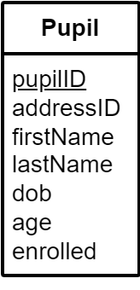
Add Data – Single Record (1) – Example
Table
1 INSERT INTO Pupil
2 VALUES (2, 2, "Tom", "Fox",
"2000-10-23", 22, FALSE);
Values in table order
PK and all validation rules must be met
If a validation rule fails, no data is inserted
Notes:
Creates a new record

Slide 97
Add Data – Single Record (1) – Example
1 INSERT INTO Pupil 2 VALUES (2, 2, "Tom", "Fox",
"2000-10-23", 22, FALSE);
Notes:
Creates a new record

Slide 98
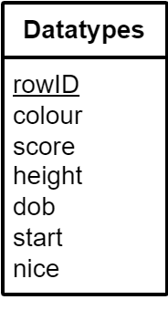
Add Data – Single Record (2) – Example
1 INSERT INTO Datatypes
2 VALUES (1001, NULL, NULL, NULL, NULL, NULL, FALSE);
Values in table order
NULL can be used when no value is available,
but PK and all validation rules must be met
If a validation rule fails, no data is inserted
Notes:
Creates a new record

Slide 99
Add Data – Single Record (2) – Example
1 INSERT INTO Datatypes
2 VALUES (1001, NULL, NULL, NULL, NULL, NULL, FALSE);
but PK and all validation rules must be met
If a validation rule fails, no data is inserted
Notes:
Creates a new record

Slide 100
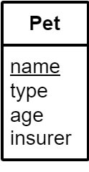
Add Data – Multiple Records – Example
Comma
1 INSERT INTO Pet
2 VALUES ("Monty", "Dog", 2, 2),
3 ("Roland", "Mouse", 1, 0);
Values in table order
PK and all validation rules must be met
If a validation rule fails, no data is inserted
Notes:
Creates two new records

Slide 101
Add Data – Multiple Records – Example
1 INSERT INTO Pet
2 VALUES ("Monty", "Dog", 2, 2),
3 ("Roland", "Mouse", 1, 0);
PK and all validation rules must be met
If a validation rule fails, no data is inserted
Notes:
Creates two new records

Slide 102
Add Data – Some Fields
Fields
1 INSERT INTO Table (field1, field2)
2 VALUES (value1, value2);
Values in field order
Same number of fields and values
All validation rules must be met
If a validation rule fails, no data is inserted
Notes:
Creates a new record

Slide 103
Add Data – Some Fields
1 INSERT INTO Table (field1, field2)
2 VALUES (value1, value2);
If a validation rule fails, no data is inserted
Notes:
Creates a new record

Slide 104
Add Data – Some Fields – Example
Fields in any order
1 INSERT INTO Datatypes (nice, rowID)
2 VALUES (TRUE, 1002);
Values in same
order as fields
Notes:
Creates a new record

Slide 105
Add Data – Some Fields – Example
1 INSERT INTO Datatypes (nice, rowID)
2 VALUES (TRUE, 1002);

Slide 106
Learning Intentions
Describe and use SQL update operations

Slide 107
Change Data
Tip: Use SELECT with WHERE first!
Table
1 UPDATE Datatypes
2 SET colour = "Mauve"
3 WHERE colour = "Mauv";
Field to update
with new value
Updates all records that match the condition!
If a validation rule fails, no data is updated
Notes:
Tip: Create a SELECT statement first with the same WHERE condition to see what will be updated.

Slide 108
Change Data
1 UPDATE Datatypes
2 SET colour = "Mauve"
3 WHERE colour = "Mauv";
If a validation rule fails, no data is updated

Slide 109
Change Data – In stages
Step 1
Step 2
1 SELECT *
2 FROM Datatypes
3 WHERE colour = "Mauv";
1 UPDATE Datatypes
2 SET colour = "Mauve"
3 WHERE colour = "Mauv";
Copy the WHERE clause!
Step 3 – Run Step 1 again

Slide 110
Change Data – In stages
1 SELECT *
2 FROM Datatypes
3 WHERE colour = "Mauv";
1 UPDATE Datatypes
2 SET colour = "Mauve"
3 WHERE colour = "Mauv";
Step 3 –

Slide 111
Change Data – Multiple fields
Tip: Use SELECT with WHERE first!
1 UPDATE Pupil
2 SET lastName = "Box",
3 addressID = 17
4 WHERE pupilID = 2;
comma
Updates all records that match the condition!
If a validation rule fails, no data is updated
Notes:
Tip: Create a SELECT statement first with the same WHERE condition to see what will be updated.

Slide 112
Change Data – Multiple fields
1 UPDATE Pupil 2 SET lastName = "Box", 3 addressID = 17 4 WHERE pupilID = 2;
If a validation rule fails, no data is updated

Slide 113
Learning Intentions
Describe and use SQL delete operations

Slide 114
Remove Data
Tip: Use SELECT with WHERE first!
Table
1 DELETE FROM Pupil
2 WHERE pupilID = 2;
Deletes all records that match the condition!
Notes:
Tip: Create a SELECT statement first with the same WHERE condition to see what will be deleted.

Slide 115
Remove Data
1 DELETE FROM Pupil
2 WHERE pupilID = 2;

Slide 116
Remove Data – In stages
Step 1
Step 2
1 SELECT *
2 FROM Pupil
2 WHERE pupilID = 2;
1 DELETE FROM Pupil
2 WHERE pupilID = 2;
Copy the WHERE clause!
Step 3 – Run Step 1 again

Slide 117
Remove Data – In stages
1 SELECT *
2 FROM Pupil
2 WHERE pupilID = 2;
1 DELETE FROM Pupil
2 WHERE pupilID = 2;
Step 3 –

Slide 118
SQL Queries - Overview
View
SELECT field(s)
FROM Table(s)
WHERE condition(s) equi-join?
ORDER BY field(s) ASC | DESC;
Add
INSERT INTO Table
VALUES (…);
(+ variations)
Modify - Danger!
UPDATE Table
SET field(s) = value(s)
WHERE condition(s);
Remove - Danger!
DELETE FROM Table
WHERE condition(s);
Italic = Optional SQL clause

Slide 119
SQL Queries - Overview
SELECT field(s)
FROM Table(s)
WHERE condition(s)
ORDER BY field(s) ASC | DESC;
INSERT INTO Table
VALUES (…);
UPDATE Table
SET field(s) = value(s)
WHERE condition(s);
DELETE FROM Table
WHERE condition(s);

Slide 120
Membership Task
Complete the Membership tasks

Slide 121
Plan – N5 Year 2
SDD
Software Design and Development (54%)
DDD
Database Design and Development (33%)
Assignment (⅓ of marks)
Computer Systems (13%)
C/Sys
Exam (⅔ of marks)
Notes:
Prelim 1: part way through DDD

Slide 122
Assessment
Assignment – 33%
Question Paper – 67%
SDD 67%
DDD 33%
Marks 40
SDD 54%
DDD 33%
Comp Sys 13%
Marks 80
Final grade out of 120
Notes:
Hide as appropriate

Slide 123
Assessment
Assignment – 40 Marks
Question Paper – 80 Marks
Analysis 3 – 6
Design 4 – 8
Implementation 22 – 24
Testing 3 – 6
Evaluation 3 – 6
Computer Systems 0
Analysis 0 – 5
Design 20 – 40
Implementation 16 – 34
Testing 5 – 10
Evaluation 0 – 5
Computer Systems 10 – 14
Final grade out of 120
Notes:
DDD: 0-5, 0-5, 7-9, 0-5, 0-5

Slide 124
GDPR
Notes:
2018 Spec Q3 2019 Q14(d)

Slide 125
Learning Intentions
Describe and identify the implications for individuals and businesses of the UK General Data Protection Regulation (UK GDPR)
Notes:
GDPR (0-17:36): https://www.youtube.com/embed/gBJXfayW40M?start=0&end=1056

Slide 126
Lawfulness, fairness and transparency
Processed lawfully, fairly and in a transparent manner in relation to individuals
Personal data is used in a way that is fair
Clear, open and honest about how personal data will be used

Slide 127
Purpose limitation
Used for the declared purpose only
Personal data can only used for a new purpose if:
compatible with original purpose
new consent gained
obligation or function set out in law

Slide 128
Data minimisation
Limited to the data needed for the declared purpose
Data must be:
adequate – sufficient to fulfil your stated purpose
relevant – has a clear link to that purpose
limited to what is necessary

Slide 129
Accuracy
Accurate
Steps taken to ensure the accuracy of personal data

Slide 130
Storage limitation
Not kept for longer than necessary

Slide 131
Integrity and confidentiality
Held securely

Slide 132
GDPR Key Principles
processed lawfully, fairly and in a transparent manner
used for the declared purpose only
limited to the data needed for the declared purpose
accurate
not kept for longer than necessary
held securely
Notes:
SQA Privacy Statement: https://www.sqa.org.uk/sqa/97458.html
Facebook Data Policy: https://en-gb.facebook.com/privacy/explanation/
Enforcement: https://www.enforcementtracker.com/
ICO: https://ico.org.uk/for-organisations/uk-gdpr-guidance-and-resources/data-protection-principles/a-guide-to-the-data-protection-principles/

Slide 133
GDPR Key Principles

Slide 134
Learning Intentions
Identify the end-user and functional requirements of a database problem

Slide 135
Requirements
End-user Requirements
Functional Requirements
The tasks that the users of the database must be able to do
The information that the database will need to hold
The SQL queries that are required to produce the results
Requirements help:
clarify the design of the database
identify the features to be implemented
evaluate if the system is fit for purpose when completed
Notes:
End-user: https://www.bbc.co.uk/bitesize/guides/zg8gpbk/revision/1
Functional: https://www.bbc.co.uk/bitesize/guides/zg8gpbk/revision/2

Slide 136
Requirements
Requirements
Requirements
The that the users of the database must be able to do
The that the database will need to hold
The SQL that are required to produce the results
Requirements help:
the design of the database
the features to be implemented
if the system is fit for purpose when completed

Slide 137
End-User Requirements
display
add
The user must be able to
specific details from context
edit
remove
Non-technical language

Slide 138
End-User Requirements

Slide 139
Functional Requirements (Queries)
select
insert
A query to
specific details from context
update
delete
Technical language

Slide 140
Functional Requirements (Queries)

Slide 141
Learning Intentions
Describe and exemplify entity-relationship diagrams with two entities indicating:
entity name
attributes
relationship (one-to-many)

Slide 142
Tables / Fields
Each table has a number of fields
Table: Teacher
Table: Department
ID | forename | surname | deptID
1 | Colin | Arthur | 001
2 | Laura | Brown | 001
3 | Scott | Sinclair | 002
4 | Michelle | Wie | 002
deptID | name | phone
001 | Maths | 300
002 | English | 301
3 fields
4 fields
Notes:
Each field has a datatype.

Slide 143
Tables / Fields
Table: Teacher
Table: Department
ID | forename | surname | deptID
1 | Colin | Arthur | 001
2 | Laura | Brown | 001
3 | Scott | Sinclair | 002
4 | Michelle | Wie | 002
deptID | name | phone
001 | Maths | 300
002 | English | 301

Slide 144
Keys
A table has a Primary Key, and can have one or more Foreign Keys
Table: Teacher
Table: Department
ID | forename | surname | deptID
1 | Colin | Arthur | 001
2 | Laura | Brown | 001
3 | Scott | Sinclair | 002
4 | Michelle | Wie | 002
deptID | name | phone
001 | Maths | 300
002 | English | 301
Primary Key
FK links to PK
Primary Key (Unique)
Foreign Key (Not unique)

Slide 145
Keys
A table has a Primary Key, and can have one or more Foreign Keys
Table: Teacher
Table: Department
ID | forename | surname | deptID
1 | Colin | Arthur | 001
2 | Laura | Brown | 001
3 | Scott | Sinclair | 002
4 | Michelle | Wie | 002
deptID | name | phone
001 | Maths | 300
002 | English | 301

Slide 146
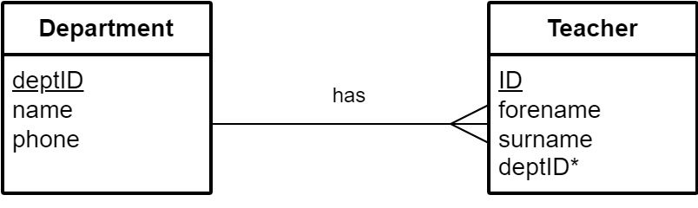
ERD 1:M
Primary
Key
Primary
Key
Foreign Key
A department can have many teachers

Slide 147
ERD 1:M

Slide 148
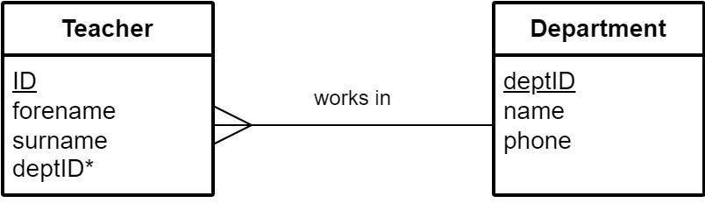
ERD M:1
Primary
Key
Primary
Key
Foreign
Key
Many teachers can work in a department

Slide 149
ERD M:1

Slide 150
Analysis and Design
What is the purpose of the database?
How will this be achieved?
End-user requirements
Functional requirements
Entities and attributes
Primary keys
Entity Relationship Diagram (ERD)
Relationships and foreign keys
Data dictionary and validation
Queries
Analysis
Design
Notes:
https://support.microsoft.com/en-gb/office/database-design-basics-eb2159cf-1e30-401a-8084-bd4f9c9ca1f5

Slide 151
Analysis and Design
What is the purpose of the database?
How will this be achieved?
Analysis
Design

Slide 152
Learning Intentions
Describe and exemplify entity-relationship diagrams with two entities indicating:
entity name
attributes
relationship (one-to-many)

Slide 153
Entities and Attributes
schoolID
name
address
phone
schoolID
name
school
Name
school
Name
Attributes
address
phone
Entity
Attribute
Notes:
More like the layout in MS Access

Slide 154
Entities and Attributes
schoolID
name
address
phone
schoolID
name
school
school
address
phone

Slide 155
Primary Key
schoolID
name
address
phone
school
pupil
pupilID
name
dob
transport
PK underlined
Entity
Notes:
More like the layout in MS Access

Slide 156
Primary Key
schoolID
name
address
phone
school
pupil
pupilID
name
dob
transport

Slide 157
Foreign Key
educates
schoolID
name
address
phone
school
pupil
pupilID
name
dob
transport
schoolID*
pupil
pupilID
name
dob
transport
Where should the Foreign Key go?
At the many end of the relationship
Notes:
More like the layout in MS Access

Slide 158
Foreign Key
schoolID
name
address
phone
school
pupil
pupilID
name
dob
transport

Slide 159
ER Diagram – Attributes (1)
schoolID
pupilID
schoolID*
name
school
educates
pupil
name
address
dob
phone
transport
PK underlined FK suffixed with *
Notes:
Shows entities, relationship, cardinality, attributes, and keys
Entity (Design) / Table (Implementation)

Slide 160
ER Diagram – Attributes (1)
schoolID
pupilID
schoolID*
name
school
pupil
name
address
dob
phone
transport
Notes:
Shows entities, relationship, cardinality, attributes, and keys
Entity (Design) / Table (Implementation)

Slide 161
ER Diagram – Attributes (2)
schoolID
name
address
phone
school
pupil
pupilID
schoolID*
name
dob
transport
educates
PK underlined FK suffixed with *
Notes:
More like the layout in MS Access

Slide 162
ER Diagram – Attributes (2)
schoolID
name
address
phone
school
pupil
pupilID
schoolID*
name
dob
transport
Notes:
More like the layout in MS Access

Slide 163
Entity Relationship Diagram
Relationship
description
entity
entity
verb
noun
noun
Attributes not always shown
Notes:
Names of relationships not stated in specification but shown.

Slide 164
Entity Relationship Diagram
Notes:
Names of relationships not stated in specification but shown. Used in H CS Specimen Task 1a

Slide 165
Cardinality: 1 to 1
1
1
name
entity
entity
leads
headteacher
school
Notes:
A school is led by a headteacher – A headteacher leads a school

Slide 166
Cardinality: 1 to 1
name
entity
entity
headteacher
school
Notes:
A school is led by a headteacher – A headteacher leads a school

Slide 167
Cardinality: 1 to Many
1
Many
name
entity
entity
educates
school
pupil
Notes:
This is what N5 uses
A school teaches many pupils – Many pupils are taught at a school

Slide 168
Cardinality: 1 to Many
name
entity
entity
school
pupil
Notes:
This is what N5 uses
A school teaches many pupils – Many pupils are taught at a school

Slide 169
Cardinality: Many to Many
Many
Many
name
entity
entity
studies
pupil
subject
Notes:
Many pupils study many subjects – Many subjects are studied by many pupils

Slide 170
Cardinality: Many to Many
name
entity
entity
pupil
subject
Notes:
Many pupils study many subjects – Many subjects are studied by many pupils

Slide 171
Cardinality
1 to 1
entity
entity
1 to Many
N5
entity
entity
Many to Many
entity
entity

Slide 172
Validation
Type
Comment
Presence check
Restricted choice
Length (text)
Range (numeric)
Must not be left blank
List of acceptable values
Minimum or exact value
Minimum and/or maximum

Slide 173
Validation
Presence check
Restricted choice
Length (text)
Range (numeric)

Slide 174
Validation - Examples
Type
Examples
Presence check
Restricted choice
Length (text)
Range (numeric)
Required
Restricted choice: Big, Small
Length >= 4
Range >= 0 and <= 100

Slide 175
Validation - Examples
Type
Presence check
Restricted choice
Length (text)
Range (numeric)

Slide 176
Learning Intentions
Describe and exemplify a data dictionary:
entity name
attribute name
primary and foreign key
attribute type
attribute size
validation

Slide 177
Data Dictionary (1)
Attribute | Key | Type | Size | Req'd | Validation
pupilID | PK | number |  | Y
schoolID | FK | number |  | Y
name |  | text | 30 | Y
dob |  | date |  | Y
transport |  | boolean |  | Y
Only text attributes have a size

Slide 178
Data Dictionary (1)
Attribute | Key | Type | Size | Req'd | Validation
pupilID | PK | number |  | Y
schoolID | FK | number |  | Y
name |  | text |  | Y
dob |  | date |  | Y
transport |  | boolean |  | Y

Slide 179
Text Attribute
Text has size!
Only text has size!

Slide 180
Text Attribute
Text has
text has

Slide 181
Data Dictionary (2)
Attribute | Key | Type | Size | Req'd | Validation
pupilID | PK | number |  | Y | Range: >= 0
schoolID | FK | number |  | Y
name |  | text | 30 | Y | Length: >= 3
dob |  | date |  | Y | Range: >= 1st Jan 2000
transport |  | boolean |  | Y
Range: numeric values
Length: text values

Slide 182
Data Dictionary (2)
Attribute | Key | Type | Size | Req'd | Validation
pupilID | PK | number |  | Y
schoolID | FK | number |  | Y
name |  | text | 30 | Y
dob |  | date |  | Y
transport |  | boolean |  | Y

Slide 183
Referential integrity
Table: Teacher
Table: Department
ID | Forename | Surname | Dept ID
1 | Colin | Arthur | 001
2 | Laura | Brown | 001
3 | Stephen | MacLeod | 001
4 | Scott | Sinclair | 002
5 | Michelle | Wie | 002
ID | Dept | Phone
001 | ICT | 300
002 | English | 301
Primary Key
FK must exist as PK
Foreign Key

Slide 184
Referential integrity
Table: Teacher
Table: Department
ID | Forename | Surname | Dept ID
1 | Colin | Arthur | 001
2 | Laura | Brown | 001
3 | Stephen | MacLeod | 001
4 | Scott | Sinclair | 002
5 | Michelle | Wie | 002
ID | Dept | Phone
001 | ICT | 300
002 | English | 301

Slide 185
Data Dictionary (3)
Attribute | Key | Type | Size | Req'd | Validation
pupilID | PK | number |  | Y | Range: >= 0
schoolID | FK | number |  | Y | Existing schoolID from School table
name |  | text | 30 | Y | Length: >= 3
dob |  | date |  | Y
transport |  | boolean |  | Y
FK linked to PK: Referential Integrity

Slide 186
Data Dictionary (3)
Attribute | Key | Type | Size | Req'd | Validation
pupilID | PK | number |  | Y | Range: >= 0
schoolID | FK | number |  | Y
name |  | text | 30 | Y | Length: >= 3
dob |  | date |  | Y
transport |  | boolean |  | Y

Slide 187
Analysis & Design
Analysis
What do the end-users need to be able to do?
What does the database need to store / do?
Design
What are the entities, relationships, cardinality? (ERD)
What are the attributes?
What are the data types?
What is the validation?
What is the referential integrity?

Slide 188
Exemplify a design of a solution to the query:
fields
multiple tables
search criteria
sort order

Slide 189
Query Design (SELECT)
Field(s)
Table(s)
Search criteria
Sort order
All can be used

Slide 190
Query Design (SELECT)
Field(s)
Table(s)
Search criteria
Sort order

Slide 191
Query Design (INSERT)
Type of query | INSERT
Table
Value(s)
Criteria | Not used

Slide 192
Query Design (INSERT)
Type of query
Table
Value(s)
Criteria

Slide 193
Query Design (UPDATE)
Type of query | UPDATE
Table
Value(s)
Criteria

Slide 194
Query Design (UPDATE)
Type of query
Table
Value(s)
Criteria

Slide 195
Query Design (DELETE)
Type of query | DELETE
Table
Value(s) | Not used
Criteria

Slide 196
Query Design (DELETE)
Type of query
Table
Value(s)
Criteria

Slide 197
Learning Intentions
Describe and exemplify testing:
SQL operations work correctly at this level
Evaluate solution in terms of:
fitness for purpose
accuracy of output

Slide 198
Testing
Compare actual output with expected output
Notes:
2018 Q20(d)(ii)

Slide 199
Fit for Purpose
Correct records:
Selected
Inserted
Updated
Deleted
Referential integrity enforced
Notes:
QP 2023 Q15(c)(i), 2019 Q17(c)(i)
Assignment 2024S 2f(ii), 2023 2e(i), 2022 2e

Slide 200
Evaluation
Fitness for purpose
Accuracy of output
Functional requirements met:
Correct search criteria
Correct sort order
Required fields displayed
No extra fields displayed
Notes:
There's more to it than this but it's a start!
Accuracy of output:
This may be related to the output not being as intended but it could also be that the SQL is correct but the database data is incorrect or has not been kept up to date. A good example of this would be a customer moving house but their address not being updated. The SQL used to search for their details would be correct but the output would not be.
Fitness for purpose:
A database system as being fit for purpose if it meets the functional requirements. The functional requirements for a database will be the data that is to be stored and how it organised along with the operations that will be performed on the database (SQL that searches, sorts, updates, inserts and deletes). The reference to functional requirements is important though as that’s how it would be phrased in any assignment or exam database question.

Slide 201
Evaluation
Fitness for purpose
Accuracy of output

Slide 202
Requirement: select the full name and town of all customers who live in Gourock, alphabetically by surname.
Fit for purpose: Yes
Accuracy of output: Yes
Fit for purpose: No
Accuracy of output: Yes
1 SELECT forename, surname, town 2 FROM Customer 3 WHERE town = "Gourock" 4 ORDER BY surname ASC;
1 SELECT forename, surname, town 2 FROM Customer 3 WHERE town = "Gourock" 4 ORDER BY surname DESC;
1
2
4
3
Fit for purpose: Yes
Accuracy of output: No
Fit for purpose: No
Accuracy of output: No
1 SELECT surname, town 2 FROM Customer 3 WHERE town = "Gourock" 4 ORDER BY surname ASC;
1 SELECT surname, town 2 FROM Customer 3 WHERE town = "Glasgow" 4 ORDER BY surname ASC;
Notes:
Example 4 from N5 CS Specification, page 69

Slide 203
Requirement: select the full name and town of all customers who live in Gourock, alphabetically by surname.
Fit for purpose:
Accuracy of output:
Fit for purpose:
Accuracy of output:
1 SELECT forename, surname, town 2 FROM Customer 3 WHERE town = "Gourock" 4 ORDER BY surname ASC;
1 SELECT forename, surname, town 2 FROM Customer 3 WHERE town = "Gourock" 4 ORDER BY surname DESC;
1
2
4
3
Fit for purpose:
Accuracy of output:
Fit for purpose:
Accuracy of output:
1 SELECT surname, town 2 FROM Customer 3 WHERE town = "Gourock" 4 ORDER BY surname ASC;
1 SELECT surname, town 2 FROM Customer 3 WHERE town = "Glasgow" 4 ORDER BY surname ASC;

Slide 204
Evaluation - Overview
Option | Fit for Purpose | Accuracy of Output | Comment
1 | Yes | Yes | Predicted records and fields
2 | No | Yes | Wrong criteria or sort Correct fields
3 | No | No | Wrong criteria or sort Missing or extra field(s)
4 | Yes | No | Correct criteria, correct sort Missing or extra field(s)

Slide 205
Evaluation - Overview
Option | Fit for Purpose | Accuracy of Output | Comment
1 | Yes | Yes
2 | No | Yes
3 | No | No
4 | Yes | No

Slide 206
Fit for Purpose
"The query is / is not fit for purpose because … "
State what is correct / incorrect
State search criteria that is / is not met
State sort order that is / is not met

Slide 207
Fit for Purpose
"The query is / is not fit for purpose because … "

Slide 208
Accuracy of Output
"The output of the query is / is not accurate because … "
State what is correct / incorrect
State the required fields that are / are not displayed
State any extra fields that are displayed

Slide 209
Accuracy of Output
"The output of the query is / is not accurate because … "

Slide 210
Learning Intentions
Create a table

Slide 211
Data Types
Type | SQL | Comment
text
number
date
time
Boolean
VARCHAR(size)
Size = max characters
INT / REAL
DATE
TIME
BOOL

Slide 212
Data Types
Type | SQL | Comment
 | VARCHAR(size) | Size =
 | INT / REAL
 | DATE
 | TIME
 | BOOL

Slide 213
Validation
Type | SQLite
Presence check | NOT NULL
Restricted choice | CHECK(field IN ("S", "M", "L"))
Field length | CHECK(LENGTH(field) = 3)
Range | CHECK(field >= 1 AND field <= 6)

Slide 214
Validation
Type | SQLite
 | NOT NULL
 | CHECK(field IN ("S", "M", "L"))
 | CHECK(LENGTH(field) = 3)
 | CHECK(field >= 1 AND field <= 6)

Slide 215
CREATE TABLE
New table name
1 CREATE TABLE table2 (
2 field1 datatype validation,
3 field2 datatype validation,
4 FOREIGN KEY(field2)
REFERENCES table1(field1),
5 PRIMARY KEY(field1)
6 );
Opening bracket
As many as required
FK
Field name
No comma
Closing bracket
Notes:
FK needed for referential integrity

Slide 216
CREATE TABLE
1 CREATE TABLE table2 (
2 field1 datatype validation,
3 field2 datatype validation,
4 FOREIGN KEY(field2)
REFERENCES table1(field1),
5 PRIMARY KEY(field1)
6 );

Slide 217
CREATE TABLE – Task 1
Entity: supplier
Attribute | Key | Type | Size | Req'd | Validation
supplierID | PK | number |  | Y
name |  | text | 30 | Y
address |  | text | 50 | Y
phone |  | text | 12 | N | length: >= 11
email |  | text | 30 | Y
active |  | boolean |  | N
Notes:
Active: active supplier or no longer used.

Slide 218
CREATE TABLE – Task 1 - Solution
1 CREATE TABLE supplier (
2 supplierID INT NOT NULL
3 name VARCHAR(30) NOT NULL,
4 address VARCHAR(50) NOT NULL,
5 phone VARCHAR(12) CHECK(LENGTH(phone) >= 11),
6 email VARCHAR(30) NOT NULL,
7 active BOOL,
8 PRIMARY KEY (supplierID)
9 );

Slide 219
CREATE TABLE – Task 2
Entity: stock
Attribute | Key | Type | Size | Req'd | Validation
stockNo | PK | number |  | Y
supplierID | FK | number |  | Y | Exists in supplier
name |  | text | 30 | Y
price |  | number |  | Y | range: >= 0.01
quantity |  | number |  | N | range: >= -1
Notes:
Quantity: -1 to indicate no longer stock, rather than all sold.

Slide 220
CREATE TABLE – Task 2 - Solution
1 CREATE TABLE stock (
2 stockCode INT NOT NULL,
3 supplierID INT NOT NULL,
4 name VARCHAR(30) NOT NULL,
5 price REAL NOT NULL CHECK(price >= 0.01),
6 quantity INT NOT NULL CHECK(quantity >= -1),
7 FOREIGN KEY (supplierID)
8 REFERENCES supplier(supplierID),
9 PRIMARY KEY (stockCode)
10 );
Notes:
FK needed for referential integrity

Slide 221
Learning Intentions
Implement or modify validation
See 2024S Task 2B Q2c

Slide 222
Modify Table – 8 Steps
Get table definition
Create empty table with modified definition
Copy all data to new table
Check data is copied
Referential integrity: Off
Delete old table
Rename new table
Referential integrity: On
If any field is used in another table as a Foreign Key (FK)
Notes:
https://www.sqlitetutorial.net/sqlite-alter-table/

Slide 223
Modify Table – 8 Steps
Get table definition
Create empty table with modified definition
Copy all data to new table
Check data is copied
Referential integrity:
Delete old table
Rename new table
Referential integrity:
Notes:
https://www.sqlitetutorial.net/sqlite-alter-table/

Slide 224
Modify Table Task
Update the staff table to ensure that a surname is required for each record

Slide 225
Database Definition
1 SELECT *
2 FROM sqlite_schema;
sqlite_schema is a table that holds information about the database

Slide 226
Database Definition
1 SELECT sql
2 FROM sqlite_schema;
is a table that holds information about the database

Slide 227
Modify Table: 1 Get Table Definition
1 SELECT sql
2 FROM sqlite_schema
3 WHERE tbl_name = "staff";
Table
CREATE TABLE staff (
staffID INT NOT NULL,
title VARCHAR(6) NOT NULL,
lastName VARCHAR(30),
role VARCHAR(15) NOT NULL,
PRIMARY KEY(staffID)
);
Output

Slide 228
Modify Table: 1 Get Table Definition
1 SELECT sql
2 FROM sqlite_schema
3 WHERE tbl_name = "staff";
CREATE TABLE staff (
staffID INT NOT NULL,
title VARCHAR(6) NOT NULL,
lastName VARCHAR(30),
role VARCHAR(15) NOT NULL,
PRIMARY KEY(staffID)
);

Slide 229
Modify Table: 1 Get Table Definition
1 .schema staff
No semi-colon
dot
Table
CREATE TABLE staff (
staffID INT NOT NULL,
title TEXT NOT NULL,
lastName TEXT,
role TEXT NOT NULL,
PRIMARY KEY(staffID)
)
Output
Semi-colon
Notes:
.schema without a table name will display all tables

Slide 230
Modify Table: 1 Get Table Definition
1 .schema staff
CREATE TABLE staff (
staffID INT NOT NULL,
title TEXT NOT NULL,
lastName TEXT,
role TEXT NOT NULL,
PRIMARY KEY(staffID)
)

Slide 231
Modify Table: 2 Create Empty Table
New table
1 CREATE TABLE newStaff (
2 staffID INT NOT NULL,
3 title VARCHAR(6) NOT NULL,
4 lastName VARCHAR(30) NOT NULL,
5 role VARCHAR(15) NOT NULL,
6 PRIMARY KEY(staffID)
7 );
New validation
No comma
Semi-colon

Slide 232
Modify Table: 2 Create Empty Table
1 CREATE TABLE newStaff (
2 staffID INT NOT NULL,
3 title VARCHAR(6) NOT NULL,
4 lastName VARCHAR(30) NOT NULL,
5 role VARCHAR(15) NOT NULL,
6 PRIMARY KEY(staffID)
7 );

Slide 233
Modify Table: 3 Copy Data
1 INSERT INTO newStaff
2 SELECT *
3 FROM staff;
New table
Old table

Slide 234
Modify Table: 3 Copy Data
1 INSERT INTO newStaff
2 SELECT *
3 FROM staff;

Slide 235
Modify Table: 4 Check Data
1 SELECT *
2 FROM newStaff;
New name

Slide 236
Modify Table: 4 Check Data
1 SELECT *
2 FROM newStaff;

Slide 237
Modify Table: 5 Referential integrity: Off
1 PRAGMA foreign_keys = off;
Specific to SQLite

Slide 238
Modify Table: 5 Referential integrity: Off
1 PRAGMA foreign_keys =

Slide 239
Modify Table: 6 Delete Old Table
1 DROP TABLE staff;
Old table

Slide 240
Modify Table: 6 Delete Table
1 DROP TABLE staff;

Slide 241
Modify Table: 7 Rename New Table
1 ALTER TABLE newStaff
2 RENAME TO staff;
New table
Old table

Slide 242
Modify Table: 7 Rename New Table
1 ALTER TABLE newStaff
2 RENAME TO staff;

Slide 243
Modify Table: 8 Referential integrity: On
1 PRAGMA foreign_keys = on;

Slide 244
Modify Table: 8 Referential integrity: On
1 PRAGMA foreign_keys =

Slide 245


Collection of Information
Physical Database
Searching can be slow
Editing is difficult
Electronic Database
+ Searching is very fast
+ Editing is easy

Slide 246
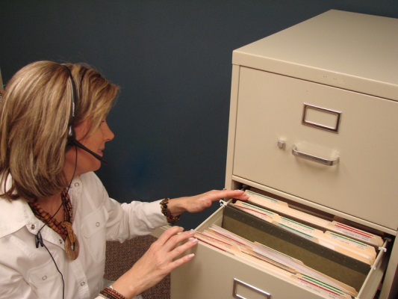

Advantages & Disadvantages
Physical Database
Searching can be slow
Editing is difficult
Electronic Database
+ Searching is very fast
+ Editing is very easy

Slide 247
Flat File Database
Data is duplicated – this can lead to errors
ID | Forename | Surname | Dept | Dept ID | Phone
1 | Colin | Arthur | ICT | 001 | 300
2 | Laura | Brown | ICT | 001 | 300
3 | Stephen | MacLeod | ICT | 001 | 300
4 | Scott | Sinclair | English | 002 | 301
5 | Michelle | Wie | English | 002 | 301
Notes:
Data from BBC Bitesize: https://www.bbc.co.uk/bitesize/guides/zc93tv4/revision/1

Slide 248
Flat File Database
ID | Forename | Surname | Dept | Dept ID | Phone
1 | Colin | Arthur | ICT | 001 | 300
2 | Laura | Brown | ICT | 001 | 300
3 | Stephen | MacLeod | ICT | 001 | 300
4 | Scott | Sinclair | English | 002 | 301
5 | Michelle | Wie | English | 002 | 301

Slide 249
Insert Anomaly
Add a new teacher to the English department
ID | Forename | Surname | Dept | Dept ID | Phone
1 | Colin | Arthur | ICT | 001 | 300
2 | Laura | Brown | ICT | 001 | 300
3 | Stephen | MacLeod | ICT | 001 | 300
4 | Scott | Sinclair | English | 002 | 301
5 | Michelle | Wie | English | 002 | 302
Insert anomaly
Notes:
BBC Bitesize: https://www.bbc.co.uk/bitesize/guides/zc93tv4/revision/2

Slide 250
Insert Anomaly
ID | Forename | Surname | Dept | Dept ID | Phone
1 | Colin | Arthur | ICT | 001 | 300
2 | Laura | Brown | ICT | 001 | 300
3 | Stephen | MacLeod | ICT | 001 | 300
4 | Scott | Sinclair | English | 002 | 301

Slide 251
Delete Anomaly
Remove all teachers who are in the English department
ID | Forename | Surname | Dept | Dept ID | Phone
1 | Colin | Arthur | ICT | 001 | 300
2 | Laura | Brown | ICT | 001 | 300
3 | Stephen | MacLeod | ICT | 001 | 300
4 | Scott | Sinclair | English | 002 | 301
5 | Michelle | Wie | English | 002 | 301
Delete anomaly
Notes:
BBC Bitesize: https://www.bbc.co.uk/bitesize/guides/zc93tv4/revision/2

Slide 252
Delete Anomaly
ID | Forename | Surname | Dept | Dept ID | Phone
1 | Colin | Arthur | ICT | 001 | 300
2 | Laura | Brown | ICT | 001 | 300
3 | Stephen | MacLeod | ICT | 001 | 300
4 | Scott | Sinclair | English | 002 | 301

Slide 253
Update Anomaly
Change the ICT department's phone to 400
ID | Forename | Surname | Dept | Dept ID | Phone
1 | Colin | Arthur | ICT | 001 | 300
2 | Laura | Brown | ICT | 001 | 300
3 | Stephen | MacLeod | ICT | 001 | 300
4 | Scott | Sinclair | English | 002 | 301
5 | Michelle | Wie | English | 002 | 301
1 | Colin | Arthur | ICT | 001 | 400
2 | Laura | Brown | ICT | 001 | 400
Update anomaly
Notes:
BBC Bitesize: https://www.bbc.co.uk/bitesize/guides/zc93tv4/revision/2

Slide 254
Update Anomaly
ID | Forename | Surname | Dept | Dept ID | Phone
1 | Colin | Arthur | ICT | 001 | 300
2 | Laura | Brown | ICT | 001 | 300
3 | Stephen | MacLeod | ICT | 001 | 300
4 | Scott | Sinclair | English | 002 | 301
5 | Michelle | Wie | English | 002 | 301
1 | Colin | Arthur | ICT | 001 | 400
2 | Laura | Brown | ICT | 001 | 400

